Slide 1
Image processing
Image processing is a method to perform some operations on an image, in order to get an enhanced image or to extract some useful information from it. It is a type of signal processing in which input is an image and output may be image or characteristics/features associated with that image.
Image processing basically includes the following three steps:
Importing the image via image acquisition tools;
Analysing and manipulating the image;
Output in which result can be altered image or report that is based on image analysis.

Slide 2
Methods used for image processing
Analogue image processing can be used for the hard copies like printouts and photographs. Image analysts use various fundamentals of interpretation while using these visual techniques.
Digital image processing techniques help in manipulation of the digital images by using computers. The three general phases that all types of data have to undergo while using digital technique are pre-processing, enhancement, and display, information extraction.

Slide 3
Digital images
Digital images are made of picture elements called pixels. Typically, pixels are organized in an ordered rectangular array. The size of an image is determined by the dimensions of this pixel array. The image width is the number of columns, and the image height is the number of rows in the array. Thus the pixel array is a matrix of M columns x N rows.

Slide 4
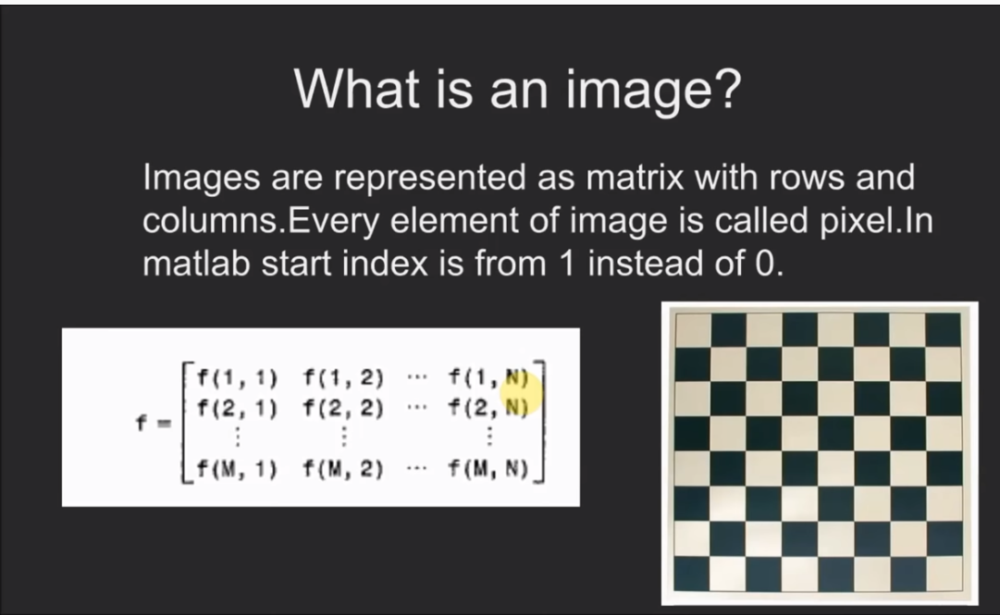

Slide 5
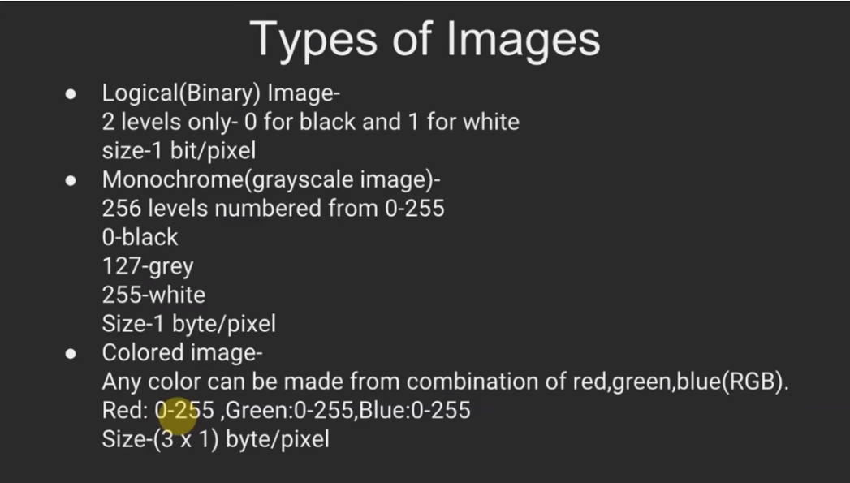

Slide 6
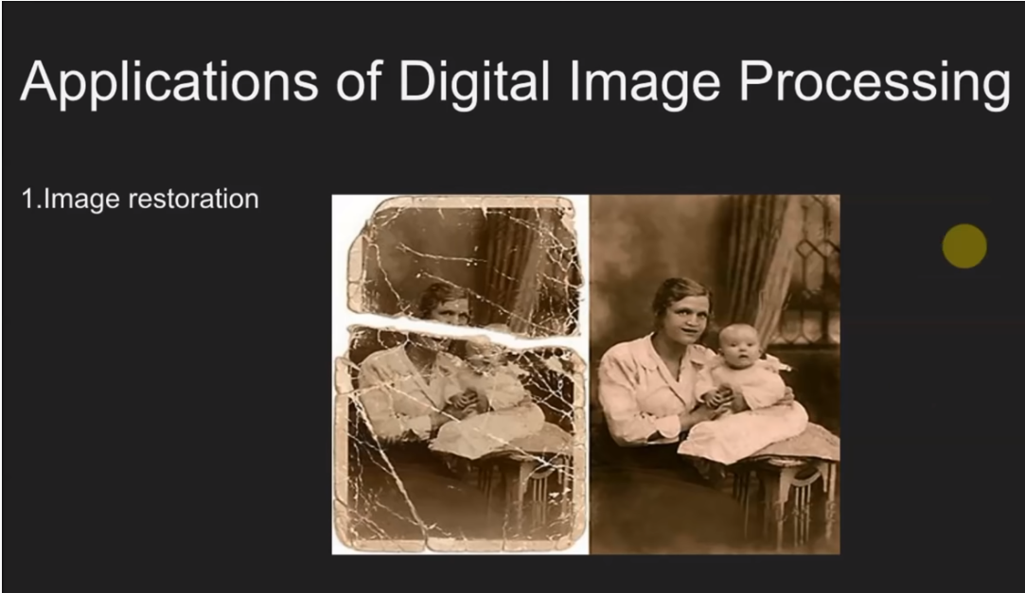

Slide 7
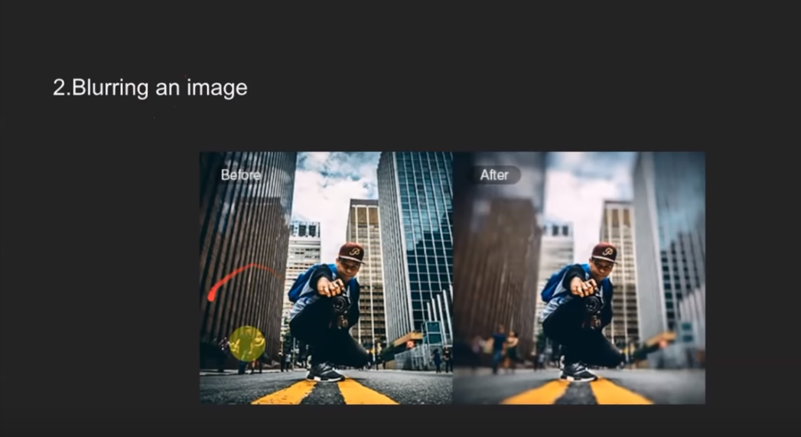

Slide 8
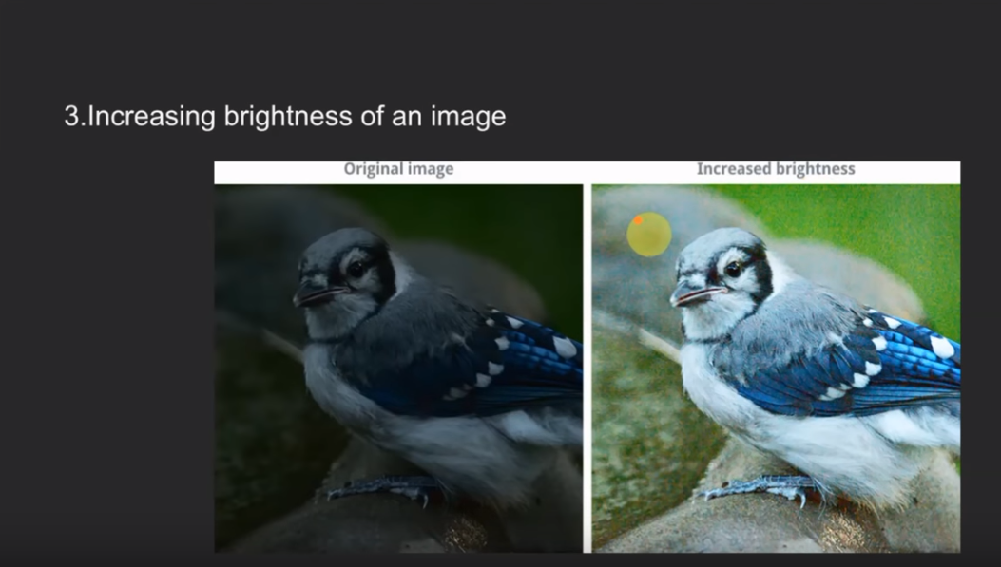

Slide 9
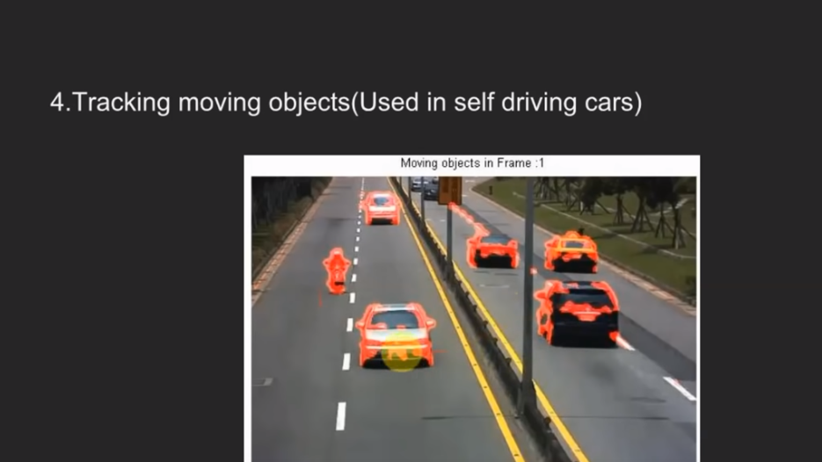

Slide 10
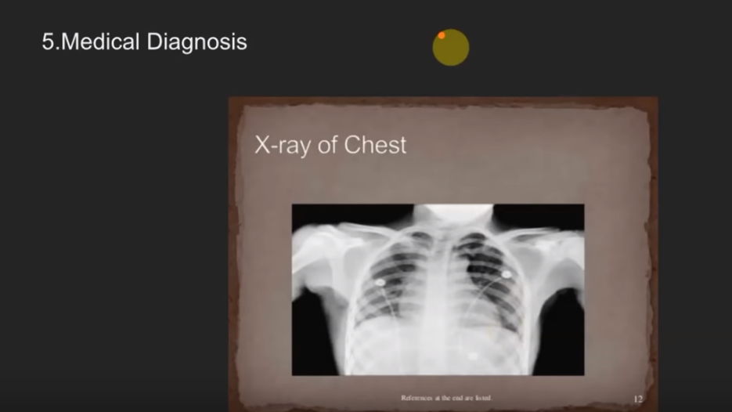

Slide 11
Purpose of Image processing
The purpose of image processing is divided into 5 groups. They are :
Visualization - Observe the objects that are not visible.
Image sharpening and restoration - To create a better image.
Image retrieval - Seek for the image of interest.
Measurement of pattern – Measures various objects in an image.
Image Recognition – Distinguish the objects in an image.

Slide 12
Fundamental steps in Image Processing
It is helpful to divide the material of digital image processing into two broad categories :
Methods whose input and output are image.
Methods whose inputs may be image, but output are attributes extracted from those images

Slide 13
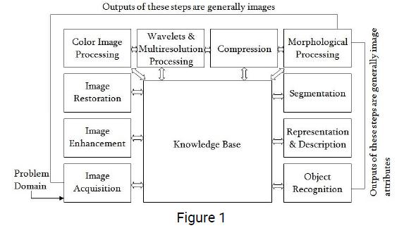

Slide 14
Image Acquisition
This is the first step or process of the fundamental steps of digital image processing. Image acquisition could be as simple as being given an image that is already in digital form. Generally, the image acquisition stage involves preprocessing, such as scaling etc.
Image Enhancement
Image enhancement is among the simplest and most appealing areas of digital image processing. Basically, the idea behind enhancement techniques is to bring out detail that is obscured, or simply to highlight certain features of interest in an image. Such as, changing brightness & contrast etc.

Slide 15
Image Restoration
Image restoration is an area that also deals with improving the appearance of an image. However, unlike enhancement, which is subjective, image restoration is objective, in the sense that restoration techniques tend to be based on mathematical or probabilistic models of image degradation.
Color Image Processing
Color image processing is an area that has been gaining its importance because of the significant increase in the use of digital images over the Internet. This may include color modeling and processing in a digital domain etc.

Slide 16
Wavelets and Multiresolution Processing
Wavelets are the foundation for representing images in various degrees of resolution. Images subdivision successively into smaller regions for data compression and for pyramidal representation.
Compression
Compression deals with techniques for reducing the storage required to save an image or the bandwidth to transmit it. Particularly in the uses of internet it is very much necessary to compress data.

Slide 17
Morphological Processing
Morphological processing deals with tools for extracting image components that are useful in the representation and description of shape.
Segmentation
Segmentation procedures partition an image into its constituent parts or objects. In general, autonomous segmentation is one of the most difficult tasks in digital image processing. A rugged segmentation procedure brings the process a long way toward successful solution of imaging problems that require objects to be identified individually.

Slide 18
Representation and Description
Representation and description almost always follow the output of a segmentation stage, which usually is raw pixel data, constituting either the boundary of a region or all the points in the region itself. Choosing a representation is only part of the solution for transforming raw data into a form suitable for subsequent computer processing. Description deals with extracting attributes that result in some quantitative information of interest or are basic for differentiating one class of objects from another.

Slide 19
Object recognition
Recognition is the process that assigns a label, such as, “vehicle” to an object based on its descriptors.
Knowledge Base:
Knowledge may be as simple as detailing regions of an image where the information of interest is known to be located, thus limiting the search that has to be conducted in seeking that information. The knowledge base also can be quite complex, such as an interrelated list of all major possible defects in a materials inspection problem or an image database containing high-resolution satellite images of a region in connection with change-detection applications.

Slide 20
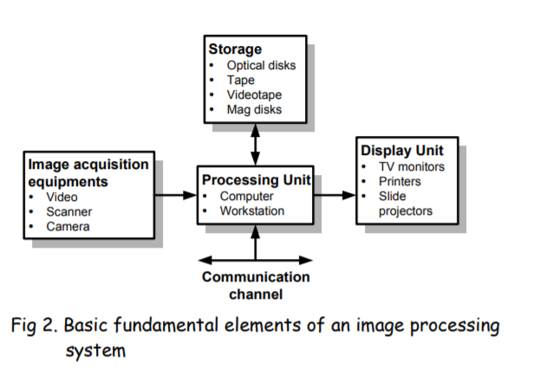
Elements of digital image processing systems:
The basic operations performed in a digital image processing systems include (1) acquisition, (2) storage, (3) processing, (4) communication and (5) display.

